Slide 1
Fort Worth ISD Literacy
North Texas P-16 Council
December 13, 2016
Adapted from the October 11, 2016 presentation to the Fort Worth ISD Board of Directors
Notes:
Presented by:
Arcelia Leon, Executive Director of Literacy K-12 & Content Area Literacy
Khechara Bradford, Assistant Superintendent; Curriculum and Instruction
Sara Arispe, Associate Superintendent; Accountability & Data Quality

Slide 2
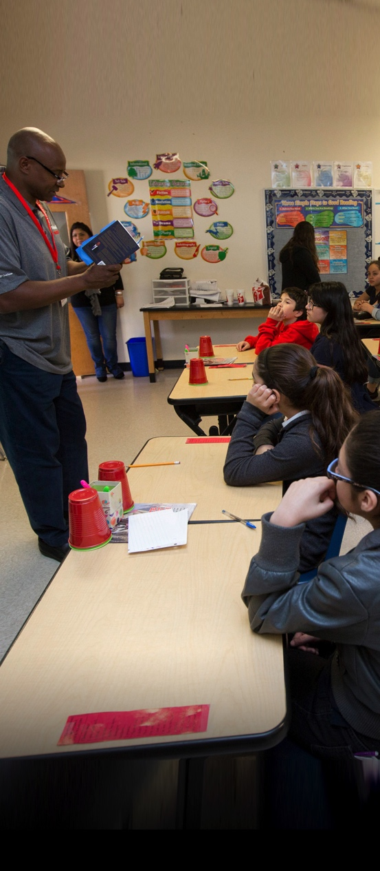
Fort Worth ISD Instruction
Focus on Tier 1 Core Instruction
Authentic Learning Experiences
Student-led Learning Opportunities
Small Groups
Utilize District Curriculum as Support
Teacher Coaching and Ongoing Professional Learning
Notes:
K. Bradford: Focus on Tier 1 Core Instruction and the literacy connection in all content areas.
Design instruction for authentic learning experiences for all students.
Provide student-led learning opportunities with teacher model and support.
Ensure daily opportunities for small group structured and guided practice.
Utilize district curriculum as support for planning that leads students to mastery of content.
Building teacher capacity for instructional delivery through a coaching model and ongoing professional learning.

Slide 3
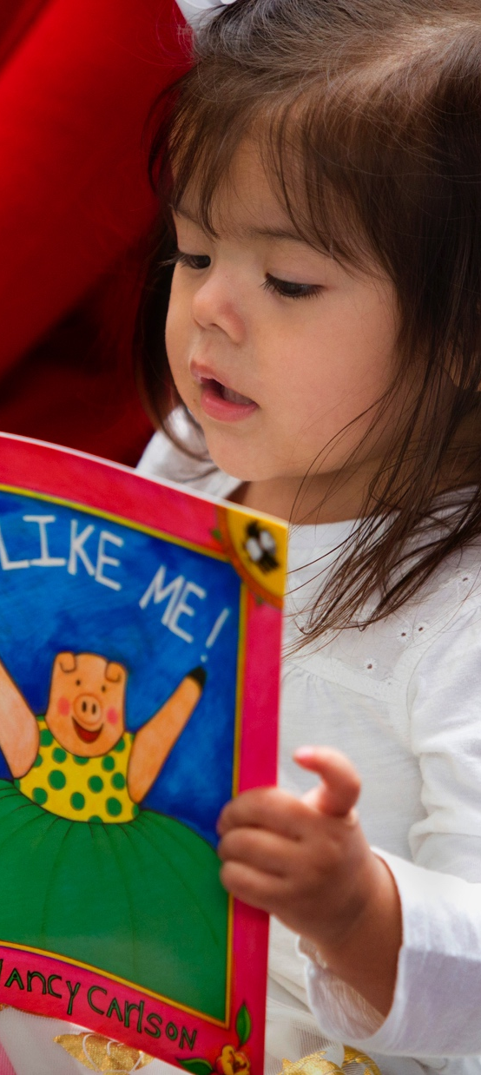
Fort Worth ISD Literacy Plan
1. Integrating Literacy Across All Content Areas
2. Implementing Effective Tier One Instruction in Balanced Literacy, and Supportive Academic Interventions
3. Aligning School Policies, Structures, and Culture for Literacy Support
4. Strengthening Instructional Leadership for Teacher Coaching and Support
5. Differentiating Teacher Professional Learning
6. Community Involvement
Notes:
Arcelia Leon

Slide 4
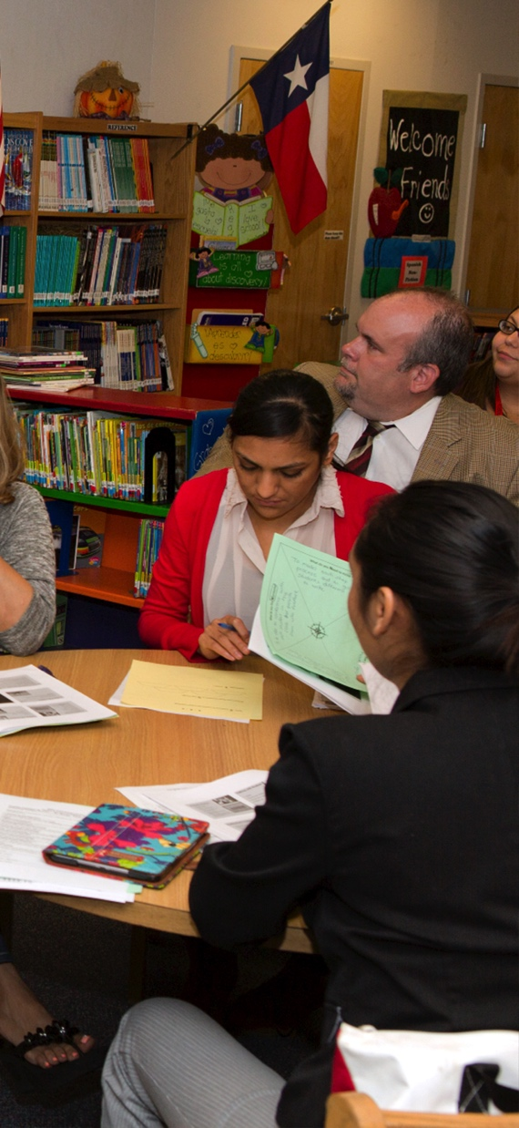
Professional Learning
Systemic instruction in early literacy
Differentiated instruction in reading and writing
Applied grammar through the writing process
Transactional Literacy
Notes:
Arcelia Leon

Slide 5
Pre-K - 2nd Grade
Writing
LD/WS
Reading
Notes:
Arcelia Leon:
The red icon represents Language Development & Word Study. That includes: oral language, phonics, phonemic awareness (letter to sound correspondence), reading fluency and comprehension. “Learning to Read”
In balanced Literacy, reading & writing are taught as interconnected skills.

Slide 6
Grades 3rd – 5th
Writing
LD/WS
Reading
Notes:
Arcelia Leon:
As students progress from ‘learning to read’ – to – ‘reading to learn’, there starts to develop a balance: word study, academic language, reading, writing.

Slide 7
Grades 6th – 8th
Writing
LD/WS
Reading
Notes:
Arcelia Leon:
Our focus in the middle school grades is on the connection between reading skills and writing application. “What you learn in reading, you apply directly into your writing.”

Slide 8
English I - IV
Writing
LD/WS
Reading
Notes:
Arcelia Leon:
The focus in ENG I-IV is on literature analysis, authentic writing, and applied grammar. We want our students to read like writers and write like readers!

Slide 9
FWISD Instructional Model
  Standard and Measurable Objective
  I Do – Teacher Modeling
  We Do –Teacher Guided Practice
  We Do Together – Student Practice with Peers
  You Do Alone – Student Independent Practice
  Student Engagement
  On-going Checks for Understanding
  Proactive Classroom Management
  Instructional Coaches
Notes:
DII

Slide 10

Achieve3000
Progress Monitoring for All Students
Differentiated Instruction
Accelerated Learning
Integrate Literacy across all Content Areas
Steadily increase students' ability to read, comprehend, apply and communicate information derived from complex
Notes:
Sara Arispe

Slide 11

Achieve3000
LevelSet Assessment – baseline Lexile
Differentiated, grade appropriate text matched to the student’s Lexile level
Ongoing assessment aligned to grade-level standards measures ability to comprehend informational text
Text rigor increased as progress is made
Notes:
Sara Arispe

Slide 12

High Expectations: All Students
200 point Lexile gain for every student
Progress monitoring throughout the year
Additional support for students not making gains as a planned part of the instructional program
Notes:
Sara Arispe

Slide 13
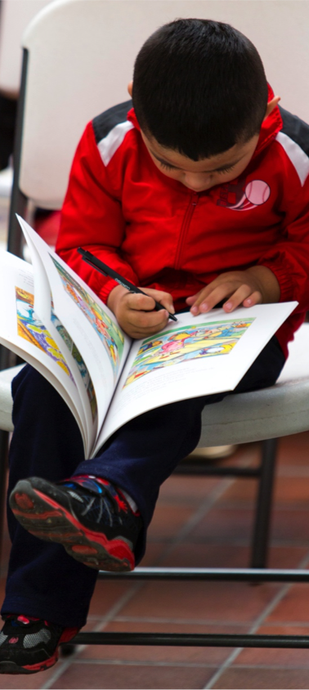
Family Connections
Accelerated Reader
ReadyRosie
Achieve3000
Volunteer Opportunities
Notes:
Arcelia Leon

Slide 14
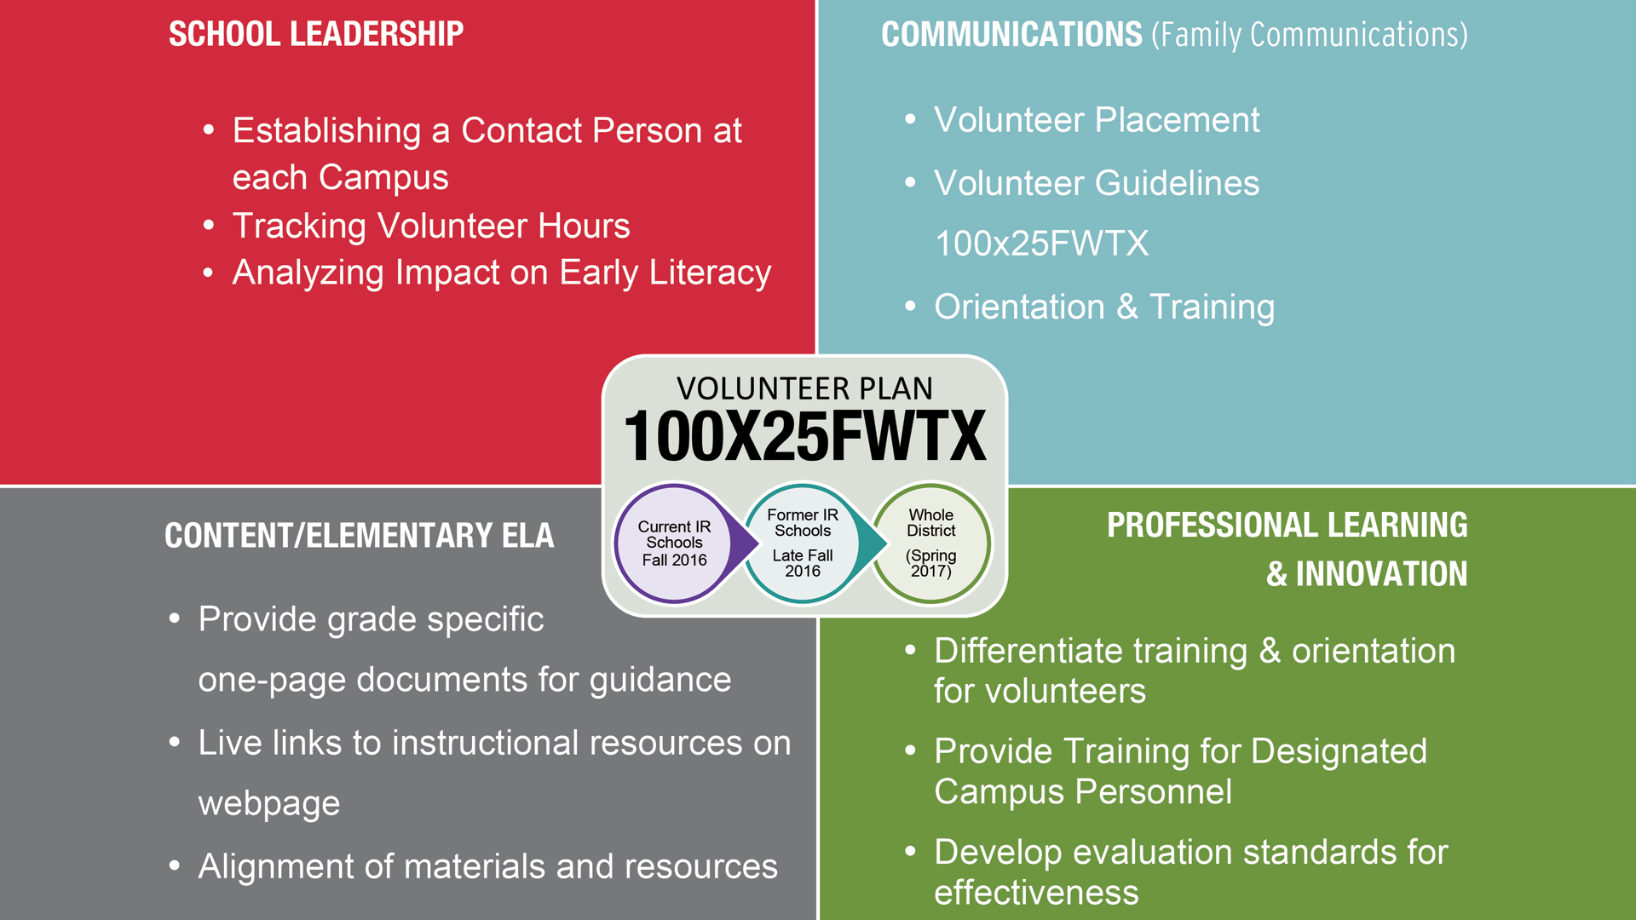
Notes:
Arcelia Leon:
This is a cross collaborative effort by the district and the community to identify volunteers for 100x25FWTX.
Key components of the plan include:
Aligning volunteer support and resources to our literacy curriculum
Providing training and orientation
Analyzing impact on early literacy

Slide 15
To Prepare All Students for College, Career, and Community Leadership
60x30TX
100% of 3rd graders reading at or above grade level by 2025
Middle school career exploration
Graduating prepared students for college and careers
TX HB 5
By 2030, at least 60% of Texans ages 25-34 will have a certificate or degree
TX HB 18
FWTX
100x25
Adapted from the November 15, 2016 presentation of the joint meeting for the Fort Worth Chamber of Commerce Quality Workforce Development Committee and Workforce Solutions for Tarrant County Workforce Improvement Committee

Slide 16
Questions

